Slide 1
Maze-Solving Robot using PID, LQR, MPC, and SMC
Team Members
  Gautham Ramkumar
  Eshwar Srinivasan
  Shriman Raghav Srinivasan
  Tapan Patil
Course : ME5659 Control Systems Engineering
Date : 14th April 2025

Slide 2
Problem Statement and Objective
Problem Statement & Objective
PROBLEM STATEMENT:
Develop a simulation framework for autonomous navigation of a unicycle robot through complex 2D maze environments. The primary goal is to accurately evaluate and compare the performance of four distinct control strategies: PID, LQR, MPC, and SMC.
PROJECT OBJECTIVES:
Design and implement a comprehensive simulation environment capable of solving maze navigation tasks using different controllers
Compare controller performance systematically across 7 different maze scenarios, varying in complexity and size
Evaluate each controller rigorously using the following performance metrics:
1. Mean Tracking Error (Accuracy of path-following)
2. Time to Reach Goal (Efficiency and speed of navigation)
3. Control Effort (Number of control steps)
Through these evaluations, identify the optimal controller characteristics for reliable and effective robotic path-following

Slide 3
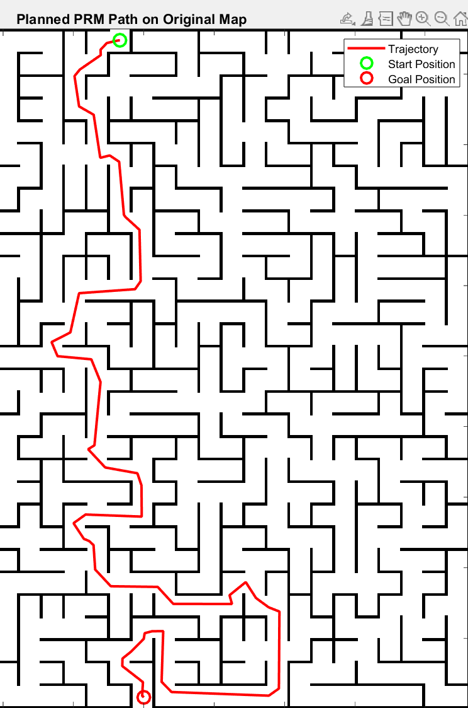


System Overview
Robot Model:
  The robot is modeled as a unicycle with state where represent the position and is the orientation.
  The control inputs are linear velocity (𝑣) and angular velocity (𝜔).
Environment:
  The environment consists of 8 mazes created from images obtained from a web-based Maze Generator. These images are then converted into binary occupancy grids:
  Black represents obstacles & White represents free space.
  The mazes are loaded from the mazeLibrary.mat file.
Path Planner :
  The Probabilistic Roadmap (PRM) algorithm is used to generate a feasible path for the robot by sampling nodes and building a roadmap based on the maze's binary map.
Controller :
  The controller section follows waypoints generated by PRM and outputs control inputs for robot model.
Simulation :
  The system is simulated in MATLAB with optional video logging and metric export for performance analysis (e.g., time to goal, control effort).

Slide 4



Controller Design : LQR
Controller Design : LQR ( Linear Quadratic Regulator )
Overview:
  LQR is an optimal control strategy used to minimize a cost function that balances tracking error and control effort.
  Designed for linear systems, LQR helps in generating smooth control inputs to follow a reference trajectory.
LQR Design:
Linearization:
  To use the LQR the system first linearized about each
  reference pose. This is done by computing the
  state-space matrices A and B that define the robot's motion.
2. Control Law :
  MATLAB's place() command is used to place poles of system at desired location for stability and performance.
  The control law computes control input µ(t) to reduce the error between the robot's current state and the reference trajectory.
3. Control Input Clamping:
  The control inputs are clamped to ensure the robot operates within its physical
  limits.

Slide 5
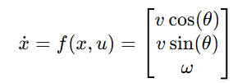
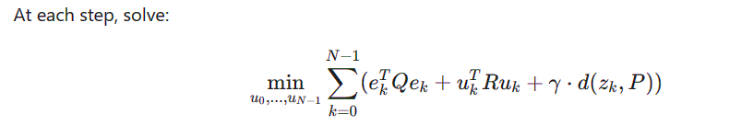
Controller Design : MPC
Controller Design : MPC
Overview:
MPC is an advanced control strategy that uses a prediction model to anticipate future system behavior where it minimizes a cost function that balances tracking error, control effort, and path proximity over a prediction horizon.
Unlike traditional controllers, MPC explicitly handles constraints on system states and control inputs and performs optimization at each time step to find the optimal control sequence
MPC Design:
Prediction Model and Horizons: ○ Our implementation uses a discrete-time unicycle model to predict future robot states:
  Prediction horizon: 25 steps (looking ahead in time)
  Control horizon: 8 steps (sequence of control actions optimized)
The minimizing cost function J is given by:
where ek-error to reference(path), N-Prediction horizon , Q ,R ,γ-Weight matrices , d(zk,P) -distance to reference.
Receding Horizon Control:
Only the first control input u0 from the optimal sequence is applied.
The optimization problem is solved again at the next time step
with updated state measurements.

Slide 6
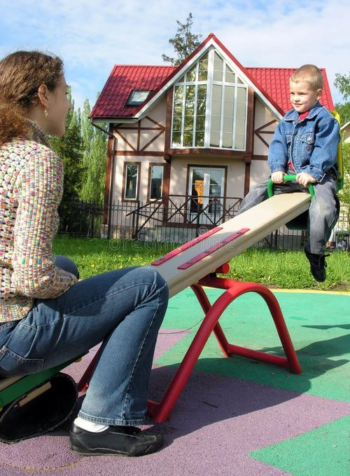
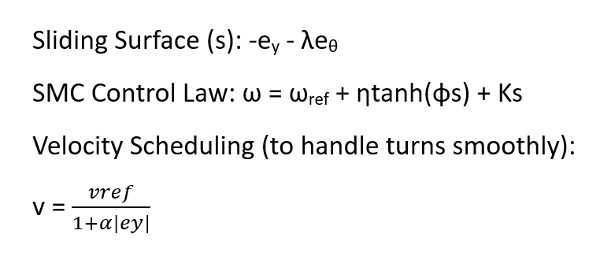
Controller Design : SMC
OVERVIEW:
Sliding Mode Control (SMC) is a robust nonlinear control method used to drive and maintain systems on a predefined equilibrium surface ("sliding surface"). It's widely used due to its robustness against uncertainties, disturbances, and model inaccuracies.
SEESAW ANALOGY:
Imagine a seesaw representing the sliding surface (s=0)
The objective: Keep the child (system state) balanced exactly at the pivot (equilibrium)
Sudden pushes can cause rapid bounces (chattering), harmful to sensors/actuators
Parents gently guiding the child = boundary layer (Smooth approximation) reducing chattering
MATHEMATICAL IMPLEMENTATION:

Slide 7
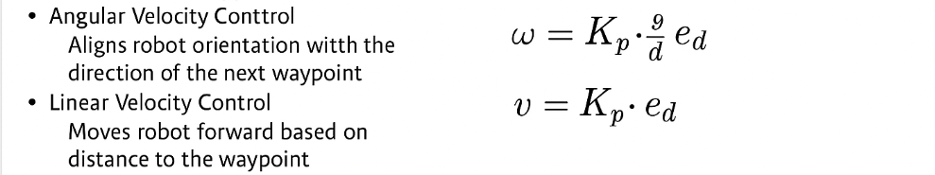
Controller Design : PID
Overview
PID (Proportional–Integral–Derivative) is a real-time feedback controller used to minimize tracking error.
Calculates control inputs based on the difference between the robot’s current state and the desired waypoint.
Ideal for systems where simplicity, speed, and responsiveness are key
Control Law
Key Features
Lightweight and efficient, suitable for fast, reactive control
Implements anti-windup and control input limits for stability
No need for system modeling, linearization, or optimization

Slide 8
Results

Slide 9

Questions please...

